Slide 1
Local Working Groups
USDA is an equal opportunity provider, employer and lender.

Slide 2
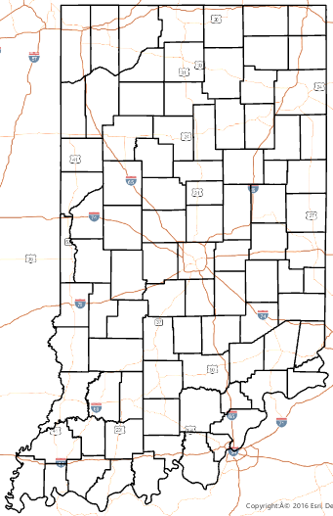
Help determine your county resource concerns
Local Working Groups
  Subcommittee of the State Technical Committee (per the 2018 Farm Bill)
  Provides county level recommendations on natural resource priorities
  Comprised of a diverse group
    Public and private entities and individuals
    Interest in conservation in the county

Slide 3



What will be the outcomes for Indiana?
Top 10 resource concerns determined
  Used to prioritize rankings for some NRCS funded programs
    Environmental Quality Incentives Program (EQIP)
    Conservation Stewardship Program (CSP)
    Regional Conservation Partnership Program (RCPP)

Slide 4
USDA NRCS Resource Concern Categories
Organizes resource concerns into groups that are functionally similar
Air Quality Emissions
Aquatic Habitat
Concentrated Erosion
Degraded Plant Condition
Field Pesticide Loss
Field, Sediment, Nutrient &
Pathogen Loss
Fire Management
Inefficient Energy Use
Livestock Production Limitation
Pest Pressure
Salt Losses to Water
Soil Quality Limitations
Source Water Depletion
Storage & Handling of Pollutants
Terrestrial Habitat
Weather Resilience
Wind & Water Erosion
Notes:
Source: https://usdagcc.sharepoint.com/sites/nrcs/intranet/Shared%20Documents/CART/CART%20Resource%20Concern%20Assessment/CART%20FY%202023%20Resource%20Concern%20Assessment%20Document/FY23%20CART%20Resource%20Concern%20Assessment%20.docx

Slide 5
Resource Concern:
Condition of a natural resource that does not meet minimum acceptable levels
  Minimum acceptable levels established by planning criteria (FOTG, Section 3)
  Implies degradation of the natural resource so that sustainability or intended use is impaired
1. Emissions of airborne reactive nitrogen
2. Emissions of greenhouse gasses (GHGs)
3. Emissions of ozone precursors
4. Emissions of particulate matter (PM) and PM precursors
5. Objectionable odor
6. Aquatic habitat for fish and other organisms
7. Elevated water temperature
8. Bank erosion from streams, shorelines or
water conveyance channels
9. Classic gully erosion
10. Ephemeral gully erosion
11. Plant productivity and health
12. Plant structure and composition
13. Pesticides transported to groundwater
14. Pesticides transported to surface water
15. Nutrients transported to groundwater
16. Nutrients transported to surface water
17. Pathogens and chemicals from manure, biosolids, or compost applications transported
to groundwater
18. Pathogens and chemicals from manure, biosolids, or compost applications transported to surface water
19. Sediment transported to surface water
20. Wildfire hazard from biomass accumulation
21. Energy efficiency of equipment and facilities
22. Energy efficiency of farming/ranching practices and field operations
23. Feed and forage balance
24. Inadequate livestock shelter
25. Inadequate livestock water quantity, quality and distribution
26. Plant pest pressure
27. Salts transported to groundwater
28. Salts transported to surface water
29. Aggregate instability
30. Compaction
31. Concentration of salts or other chemicals
32. Organic matter depletion
33. Soil organism habitat loss or degradation
34. Subsidence
35. Groundwater depletion
36. Inefficient irrigation water use
37. Surface water depletion
38. Nutrients transported to groundwater – storage and handling of pollutants
39. Nutrients transported to surface water – storage and handling of pollutants
40. Petroleum, heavy metals and other pollutants (ex. agrichemical mix sites) transported to groundwater
41. Petroleum, heavy metals and other pollutants (ex. agrichemical mix sites) transported to surface water
42. Terrestrial habitat for wildlife and invertebrates
43. Drifted snow
44. Naturally available moisture use
45. Ponding and flooding
46. Seasonal high water table
47. Seeps
48. Wind erosion
49. Sheet and rill erosion

Slide 6
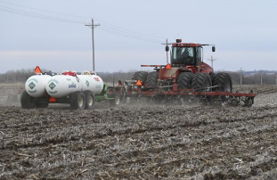
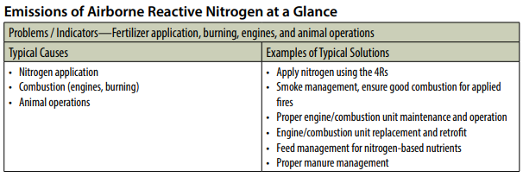
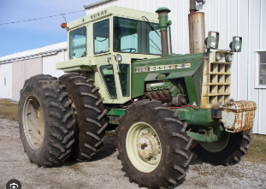
AIR QUALITY EMISSIONS – Emissions of airborne reactive nitrogen
Negatively impacts atmospheric chemistry
Causes unwanted fertilization via deposition in sensitive ecosystems
Degrade regional visibility.

Slide 7
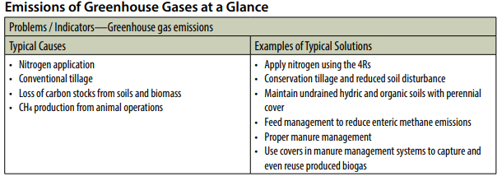
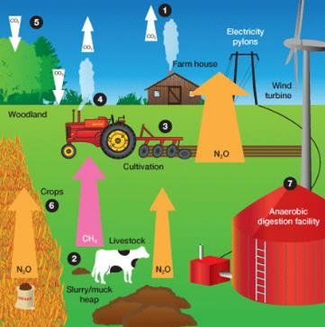

AIR QUALITY EMISSIONS – Emissions of greenhouse gases (GHGs)

Slide 8
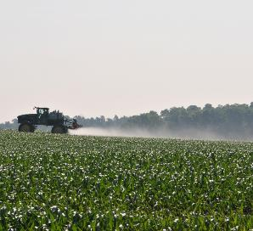
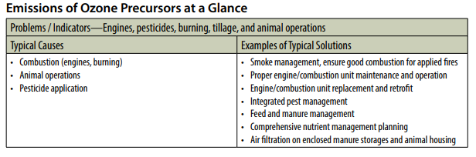
AIR QUALITY EMISSIONS – Emissions of ozone precursors

Slide 9
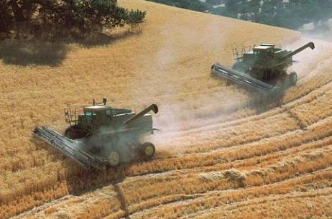
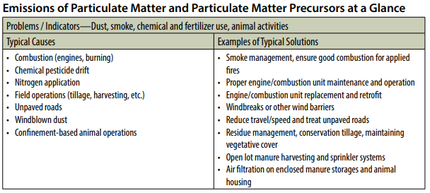
AIR QUALITY EMISSIONS – Emissions of particulate matter (PM) and PM precursors
Direct emissions of particulate matter (dust and smoke)
Formation of fine particulate matter from other agricultural emissions (ammonia, NOx and VOCs)

Slide 10
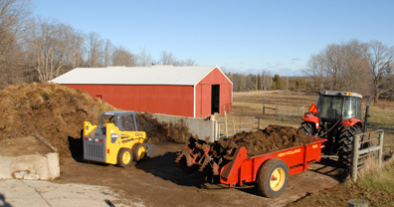
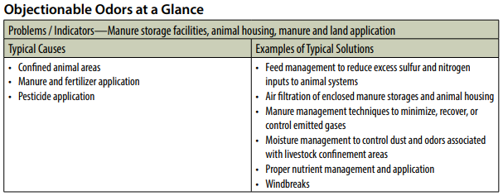
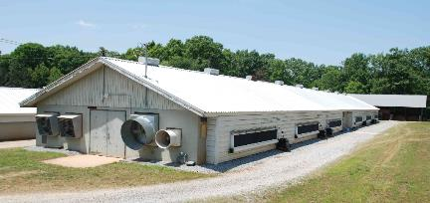
AIR QUALITY EMISSIONS – Objectionable odor
Emissions of odorous compounds (VOCs, ammonia, and odorous sulfur compounds)

Slide 11
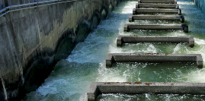
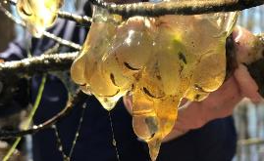
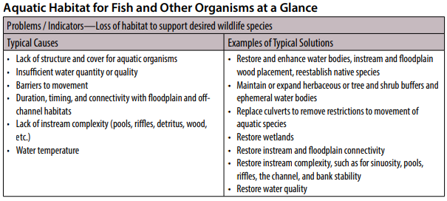
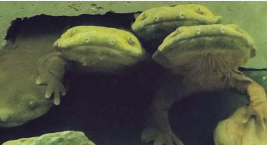
AQUATIC HABITAT – Aquatic habitat for fish & other organisms
Needs of identified aquatic life not being met including:
  Quantity, quality or connectivity of water
  Food
  Cover
  Space

Slide 12
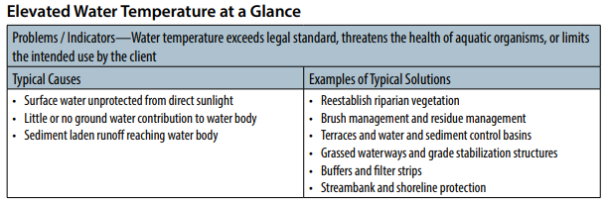
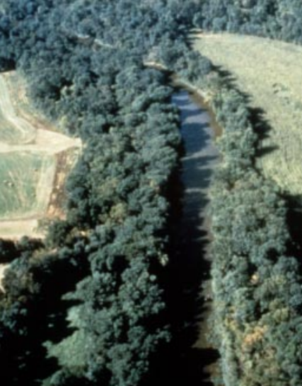
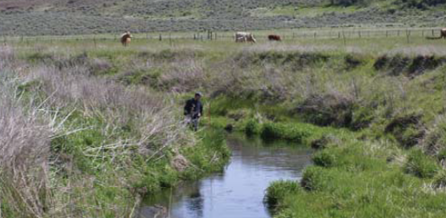
AQUATIC HABITAT – Elevated water temperature

Slide 13
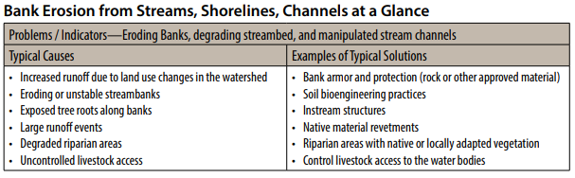
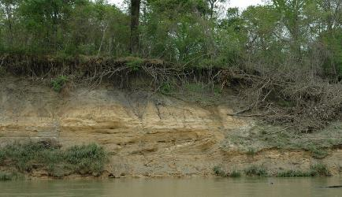
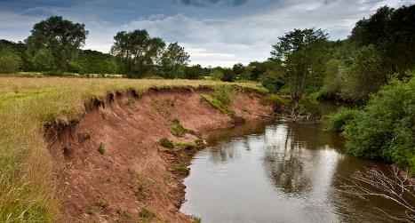
CONCENTRATED EROSION –
Bank erosion from streams, shorelines or water conveyance channels

Slide 14
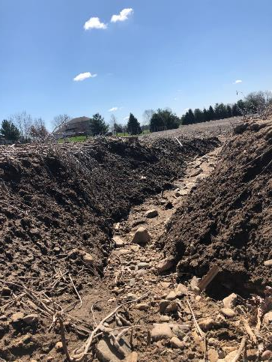
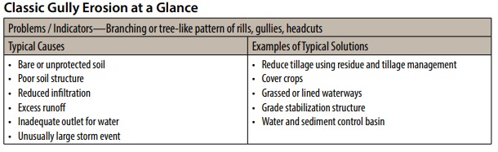
CONCENTRATED EROSION – Classic gully
Gully large enough that field equipment cannot drive through
Progressively enlarges if left untreated
Occurs in areas where water concentrates, then flows downhill
Photo credit: Amanda Kautz

Slide 15
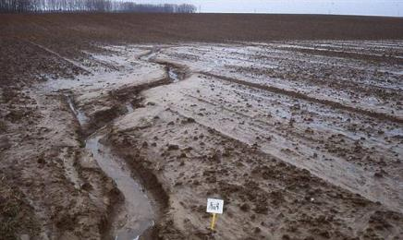
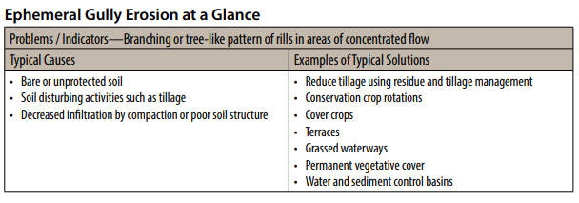
CONCENTRATED EROSION – Ephemeral gully
Gully small enough that field equipment can drive through
Often obscured by tillage
Occurs in areas where water concentrates, then flows downhill.

Slide 16
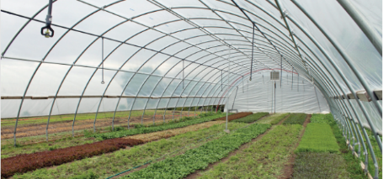
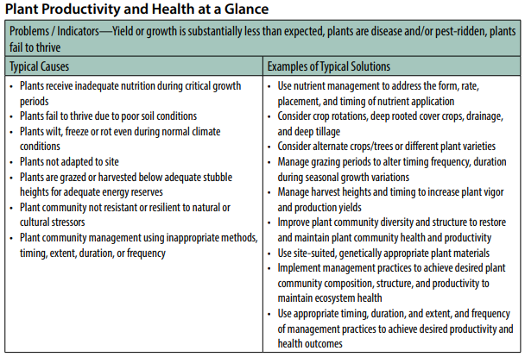
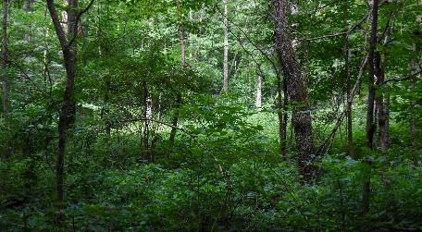
DEGRADED PLANT CONDITION –Plant productivity and health
Typical forestry resource concern related to stocking level addressed with Forest Stand Improvement
Typical resource concern for High Tunnel Systems

Slide 17
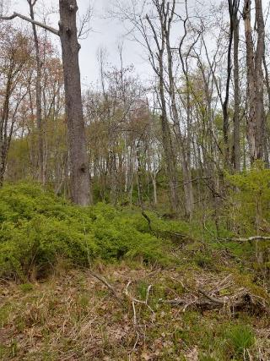
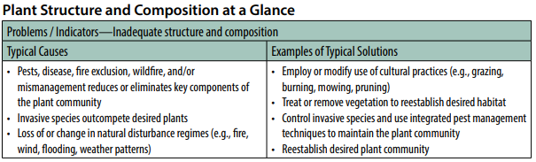
DEGRADED PLANT CONDITION - Plant structure and composition
Can include loss of unique plant communities/ecosystems
Typical forest resource concern addressed with Forest Stand Improvement and/or Brush Management – including oak regeneration.

Slide 18
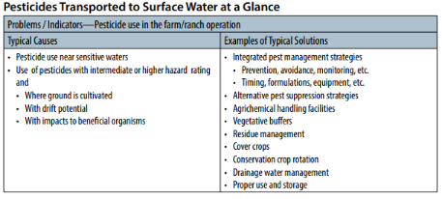
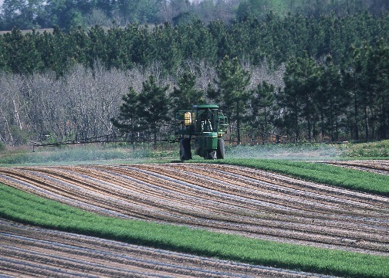
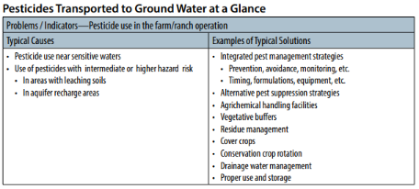
FIELD PESTICIDE LOSS – Pesticides transported to ground and surface waters
Pesticide losses from fields due to runoff, leaching, drift, etc.

Slide 19
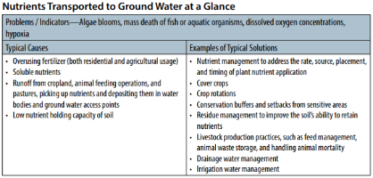
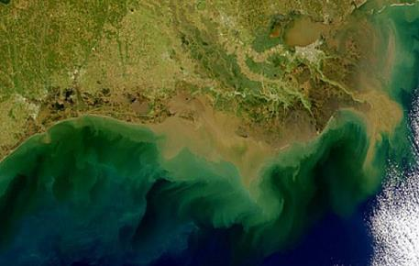
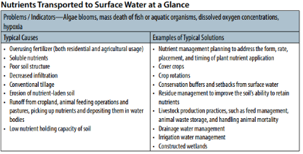
FIELD SEDIMENT, NUTRIENT and PATHOGEN LOSS – Nutrients in ground and surface waters
Nutrient losses from fields due to fertilizer, manure, etc.
Causes algae blooms and other local issues.

Slide 20
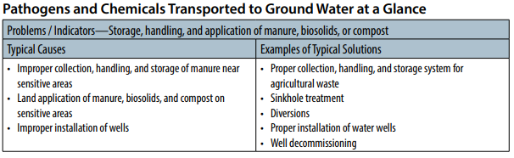
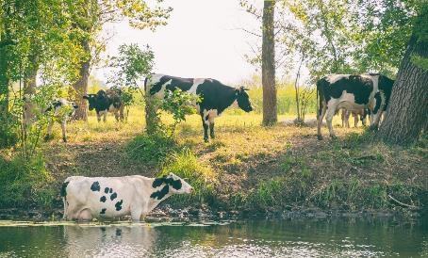
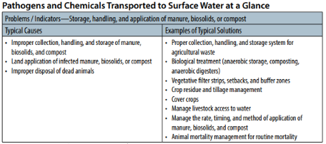
FIELD SEDIMENT, NUTRIENT and PATHOGEN LOSS – Pathogens and chemicals from manure, biosolids or compost applications
Typically caused by livestock access to surface or groundwater, or runoff of manure from fields and pastures.

Slide 21
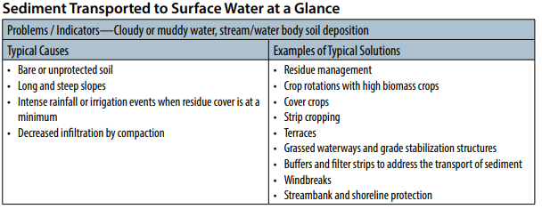
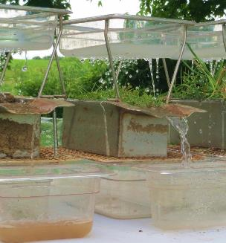
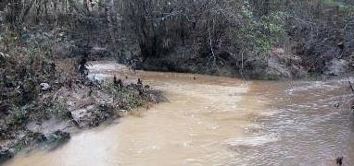
Field Sediment, Nutrient and Pathogen Loss – Sediment in surface waters
Caused by sheet/rill, wind, gully, and bank erosion

Slide 22
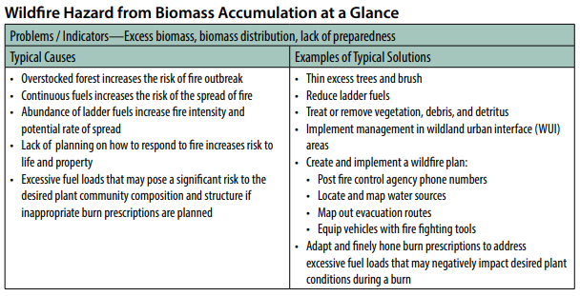
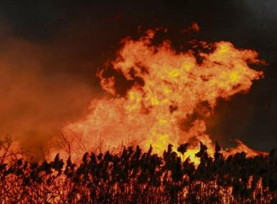
FIRE MANAGEMENT - Wildfire hazard from biomass accumulation

Slide 23
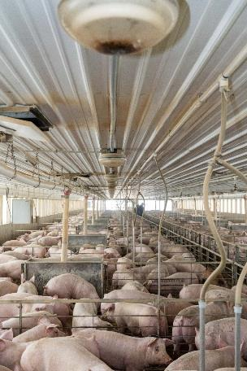
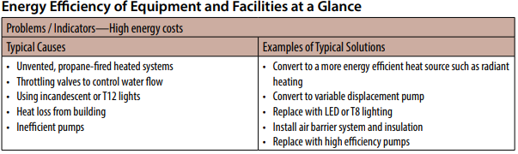
INEFFICIENT ENERGY USE – Energy efficiency of equipment and facilities
Inefficient use of energy in the farm operation
Solutions include improving energy efficiencies such as lighting, insulation, etc.

Slide 24
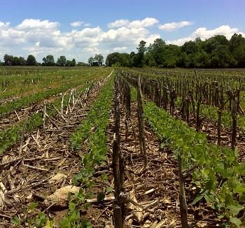
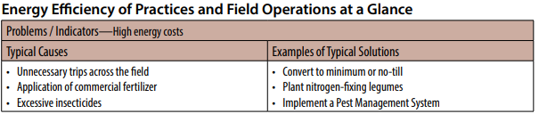
INEFFICIENT ENERGY USE – Energy efficiency of farming/ranching practices and field operations
Inefficient use of energy in field operations
Solutions include:
  Reducing energy inputs
  Improved nutrient efficiency
  No-Till
Photo by Amanda Kautz

Slide 25


LIVESTOCK PRODUCTION LIMITATION - Feed and forage balance
Feed/forage quality or quantity is inadequate

Slide 26


LIVESTOCK PRODUCTION LIMITATION - Inadequate livestock shelter

Slide 27



LIVESTOCK PRODUCTION LIMITATION – Inadequate livestock water
Insufficient quantity, quality and/or distribution of drinking water
Can have other environmental impacts from animals traveling long distances to adequate water = trailing

Slide 28



PEST PRESSURE - Plant pest pressure
Photo credit: Purdue University Weed Science Department
Excessive pest damage to plants impacting production goals
  Examples include:
    Herbicide resistant weeds
    Invasive plants

Slide 29



SALT LOSSES to WATER – Salts transported to ground and surface waters
Not common in Indiana

Slide 30


SOIL QUALITY LIMITATIONS – Aggregate instability
Degradation of water stable soil aggregates cause by management resulting in:
  destabilized soil carbon
  increased surface crusting
  reduced water infiltration
  reduced water holding capacity and aeration
  depressed resilience to extreme weather
  increased ponding and flooding
  increased soil erosion and plant stress
  reduced soil biological activity

Slide 31



SOIL QUALITY LIMITATIONS – Compaction
Soil compaction from equipment and Livestock
Resulting in:
  decreased rooting depth
  reduced water infiltration
  reduced soil biological activity

Slide 32


SOIL QUALITY LIMITATIONS – Concentration of salts or other chemicals
Leads to soil salinity and/or sodicity
Not common in Indiana

Slide 33


SOIL QUALITY LIMITATIONS – Organic matter depletion
Management-induced depletion of any/all pools of soil organic matter
Results in limited soil function and processes:
  decreased plant productivity
  decreased biological activity
  decreased water and nutrient cycling

Slide 34


SOIL QUALITY LIMITATIONS – Soil organism habitat loss or degradation
Inadequate food, cover, space, shelter and/or water for beneficial soil organisms
  quantity
  quality
  diversity
  connectivity

Slide 35


SOIL QUALITY LIMITATIONS – Subsidence
Loss of volume and depth of organic soils
Oxidation caused by above normal microbial activity
Caused from:
  excessive water drainage
  soil disturbance
  extended drought

Slide 36



SOURCE WATER DEPLETION – Ground and surface water depletion
Surface water is used at a rate that is detrimental to ecological functions or other identified uses
Underground water is used at a rate greater than aquifer recharge

Slide 37


SOURCE WATER DEPLETION – Inefficient irrigation water use
Irrigation water is not stored, delivered, scheduled and/or applied efficiently
Aquifer or surface water withdrawals threaten sustained availability of ground or surface water

Slide 38

Storage and Handling of Pollutants – Nutrients in surface and ground waters
Nutrients from livestock and/or stored manure, fertilizers, etc. are moving offsite through surface runoff and/or leaching

Slide 39



Storage and Handling of Pollutants – Petroleum, heavy metals, and other pollutants transported to receiving water sources

Slide 40



TERRESTRIAL HABITAT – Terrestrial habitat for wildlife
Needs of identified terrestrial life not being met:
  Quantity, quality or connectivity
  Food
  Cover
  Space
  Shelter
  Water
Includes wildlife and invertebrate species

Slide 41




WEATHER RESILIENCE – Drifted snow, ponding & flooding, seasonal high water table and seeps
Surface water or poor subsurface drainage
Wind-blown snow accumulates around and over structures

Slide 42


WEATHER RESILIENCE - Naturally available moisture use
Natural precipitation is not optimally managed

Slide 43





WIND & WATER EROSION – Sheet, rill and wind
Detachment and transport of soil particles
Degrades soil quality
Caused by:
  rainfall runoff/splash
  irrigation runoff
  Wind
Includes Woodland erosion on
trails or log yards

Slide 44
Helping People Help the Land
Notes:
Essentially you'll be helping people help the land. This is our mission as part of the NRCS Team.

Slide 45
Questions
Notes:
Questions?

Slide 46
USDA is an equal opportunity provider and employer. "The U.S. Department of Agriculture (USDA) prohibits discrimination in all of its programs and activities on the basis of race, color, national origin, age, disability, and where applicable, sex (including gender identity and expression), marital status, familial status, parental status, religion, sexual orientation, political beliefs, genetic information, reprisal, or because all or part of an individual's income is derived from any public assistance program. (Not all prohibited bases apply to all programs.) Persons with disabilities who require alternative means for communication of program information (Braille, large print, audiotape, etc.) should contact USDA's TARGET Center at (202) 720-2600 (voice and TDD)." To file a complaint of discrimination, write to: USDA Assistant Secretary for Civil Rights, Office of the Assistant Secretary for Civil Rights1400 Independence Avenue, S.W., Stop 9410, Washington, DC 20250-9410, or call toll-free at (866) 632-9992 (English) or (800) 877-8339 (TDD) or (866) 377-8642 (English Federal-relay) or (800) 845-6136 (Spanish Federal-relay).

